Slide 1
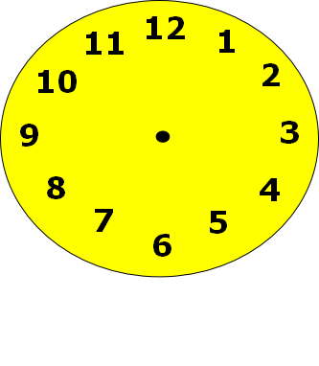
Telling the time.

Slide 2
What time is it?
1 o’clock
12 o’clock
2 o’clock

Slide 3
Try again

Slide 4
Well done!
Play again

Slide 5
What time is it?
4 o’clock
5 o’clock
12 o’clock

Slide 6
Try again

Slide 7
Well done!
Play again

Slide 8
What time is it?
12 o’clock
9 o’clock
8 o’clock

Slide 9
Try again

Slide 10
Well done!
Play again

Slide 11
What time is it?
6 o’clock
12 o’clock
5 o’clock

Slide 12
Try again

Slide 13
Well done!
Play again

Slide 14
What time is it?
1 o’clock
3 o’clock
12 o’clock

Slide 15
Try again

Slide 16
Well done!
Play again

Slide 17
What time is it?
11 o’clock
12 o’clock
1 o’clock

Slide 18
Try again

Slide 19
Well done!
Play again

Slide 20
What time is it?
8 o’clock
12 o’clock
7 o’clock

Slide 21
Try again

Slide 22
Well done!
Press here for a certificate

Slide 23
Well done! You can read o’clock times.
Awarded to:_ _ _ _ _ _ _ _ _ _ _ _ _ _

